Slide 1
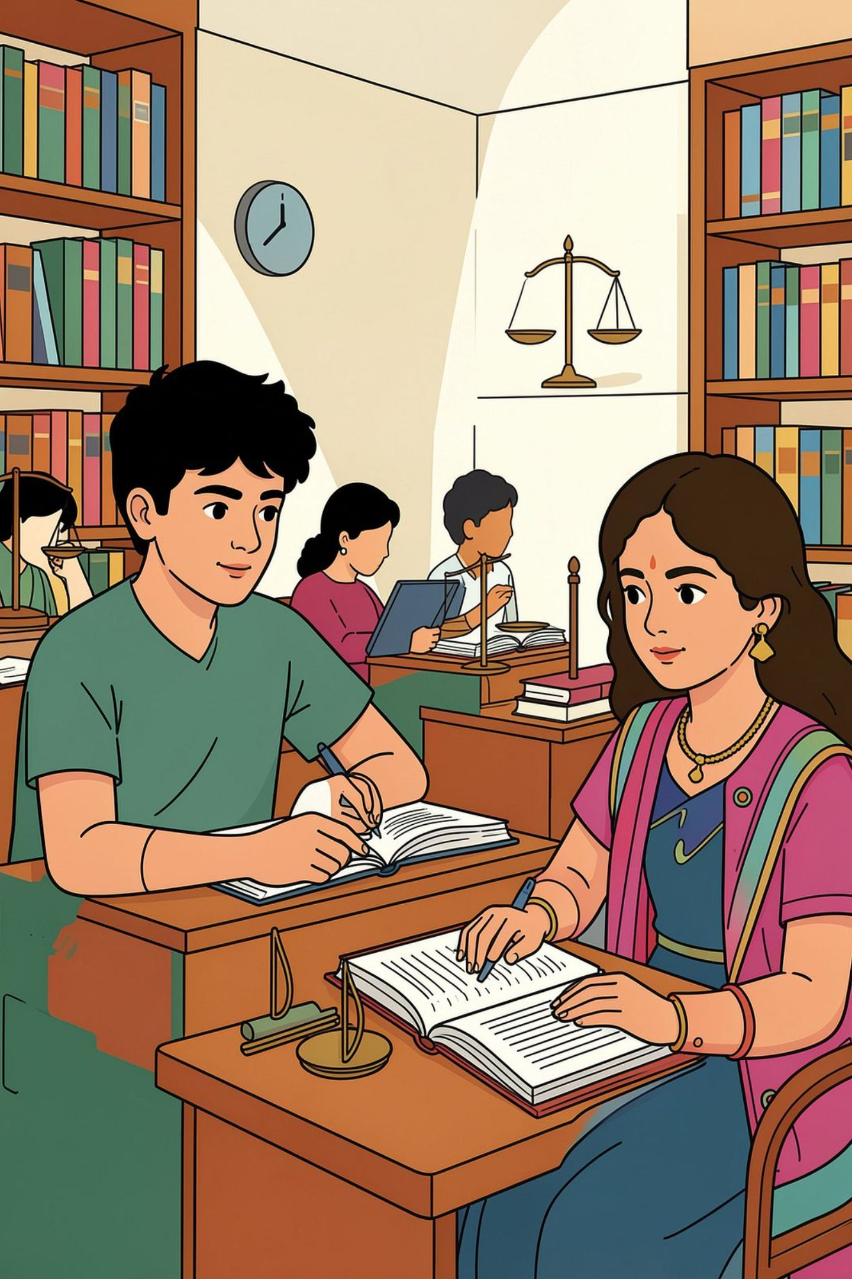
POCSO's Paradox: When Child Protection Law Erases Adolescent Agency
A critical examination for legal professionals on how the Protection of Children from Sexual Offences Act, 2012 and surrounding policies can harm the very adolescents it seeks to protect.

Slide 2
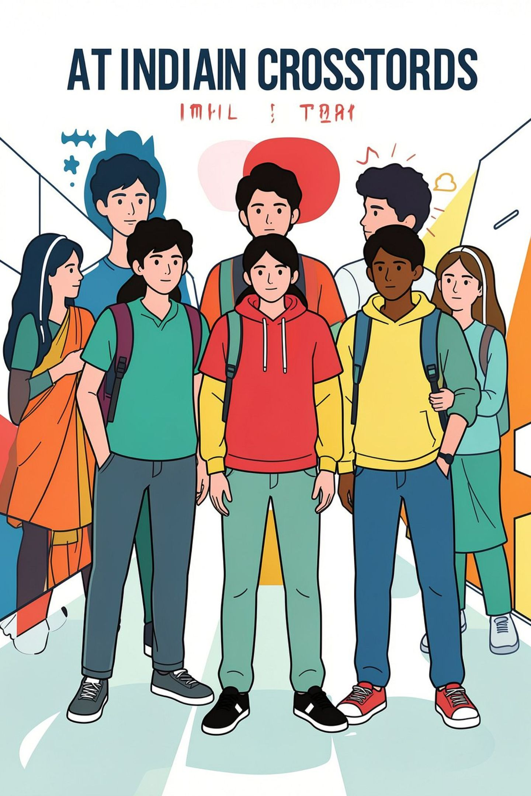
The Core Tension
What the Law Does
POCSO Act (2012) criminalizes all sexual contact with anyone under 18, regardless of consent, intent, or the nature of the relationship.
What the Law Ignores
An age of consent fixed at 18 treats all adolescents as categorically incapable of consent — erasing the developmental realities of 16- and 17-year-olds.
The Paradox
The law operates by removing choice, in many instances. It silences adolescent voices in their own cases, substituting the State's narrative for the adolescent's lived experience.

Slide 3

CASE STUDY 1 — DELHI
The Girl Who Wasn't Heard
A 17-year-old at the time of the 'incident' — now 18 — has maintained through every stage of legal proceedings:
"I chose this relationship and I want to marry him."
She has consistently stated she was not coerced or forced — she does not see herself as a victim
Years of court involvement disrupted her education and life while she gave unwavering testimony of consent
The legal system imposed a "victim" identity directly against her stated wishes and self-understanding

Slide 4
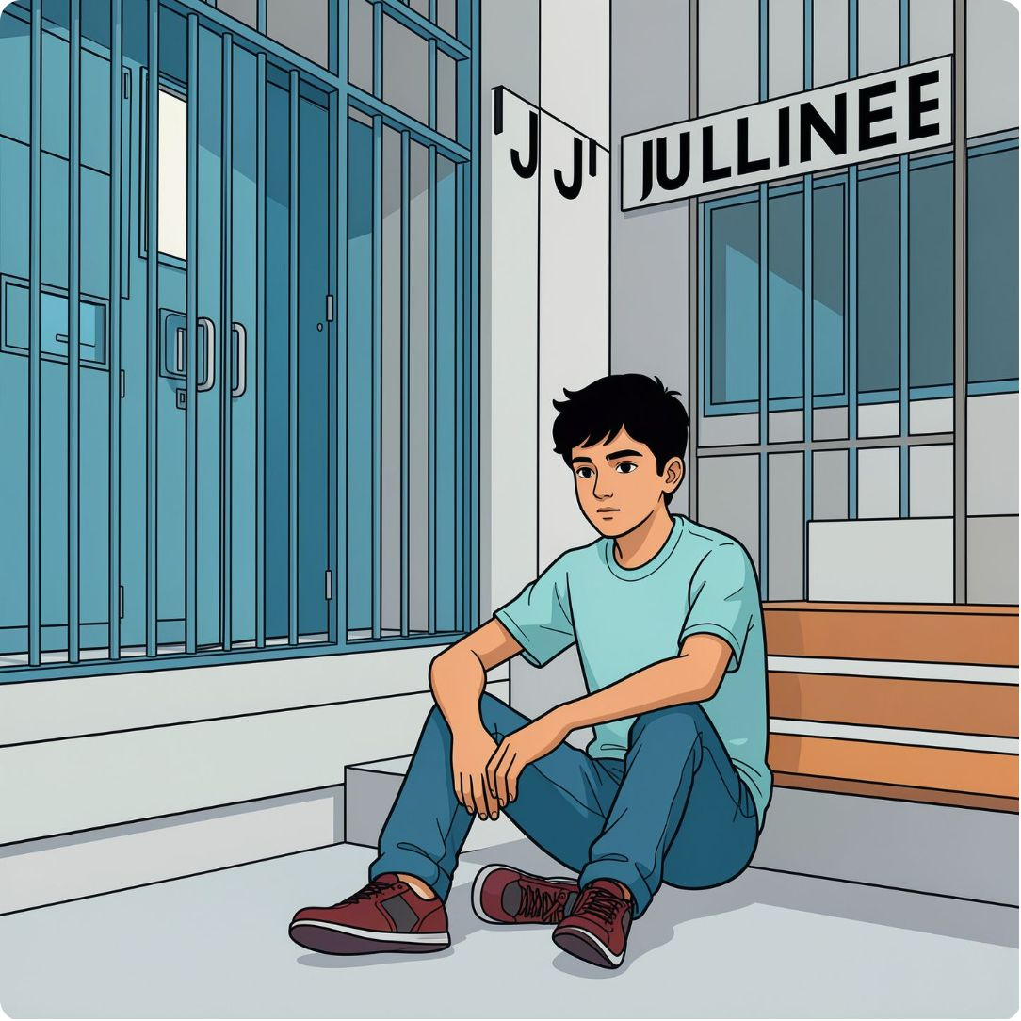
CASE STUDY 2 — RAJASTHAN
The law weaponised
A 15-year-old boy in a consensual relationship with his 14-year-old distant cousin was detained for over 6 months in an observation home
The girl's family threatened his family and weaponized POCSO as a tool of coercion; the girl later died by suicide — reportedly under immense family pressure
Upon learning of her death, his first words were: "Ab main jeeke kya karunga" — "What will I do with my life now?"
He now lives away from home, in ongoing fear of the girl's family

Slide 5


Violation of Girls' Dignity: Imposed Victimhood
Erased Agency
Burdensome Proceedings
Girls in consensual relationships are legally stripped of agency and recast as "victims" — a label they themselves reject.
Court processes force girls to repeatedly defend relationships they chose, treating their own testimony as legally irrelevant.
Family Weaponization
Criminalizing the boy makes dialogue impossible and amplifies family pressure, trapping girls between law and kin.
Supporting the child does not mean deciding what the "right" outcome should be. It means listening to their views, understanding them — without allowing assumptions to replace their voice.

Slide 6
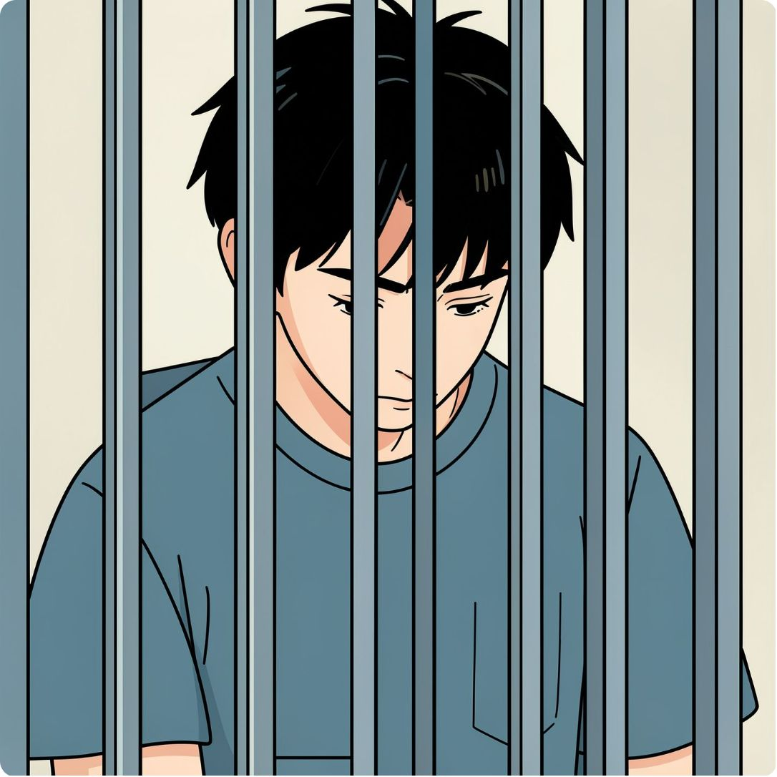
Violation of Boys' Dignity: Criminalization Without Proportionality
1
2
3
No Distinction in Law
Institutional Detention
Lifelong Consequences
POCSO makes no distinction between predatory abuse and consensual adolescent relationships — a 15-year-old in love is prosecuted identically to a predator.
Six or more months in observation homes for consensual acts — combined with harsh bail conditions and financial burdens on families unable to arrange sureties.
Criminal records (for 16+), social stigma, displacement from home, and psychological trauma — all for a relationships seen as part of teenage development.

Slide 7
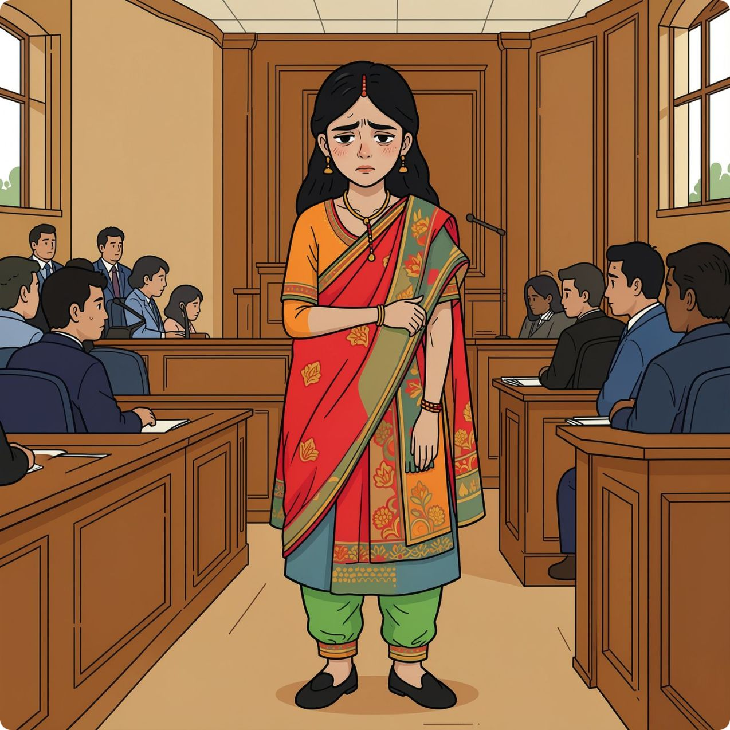
The Girl Who Wasn't Heard — A Timeline of Silencing
FIR Registered
1
Survivor is 17 years old. Immediately labeled "victim" under POCSO despite stating consent from day one.
2
Early Proceedings
Survivor repeatedly asserts: "I chose this relationship. I want to marry him." Her testimony is consistent across all legal stages.
Years Pass
3
Court proceedings continue. Survivor relocates to Mumbai for work/education. Her parents move to their village. The case remains unresolved.
4
Present Day
Survivor is now 18. Still asserting consent. Still fighting to have the case quashed. The legal system continues to impose "victim" identity against her stated wishes.

Slide 8
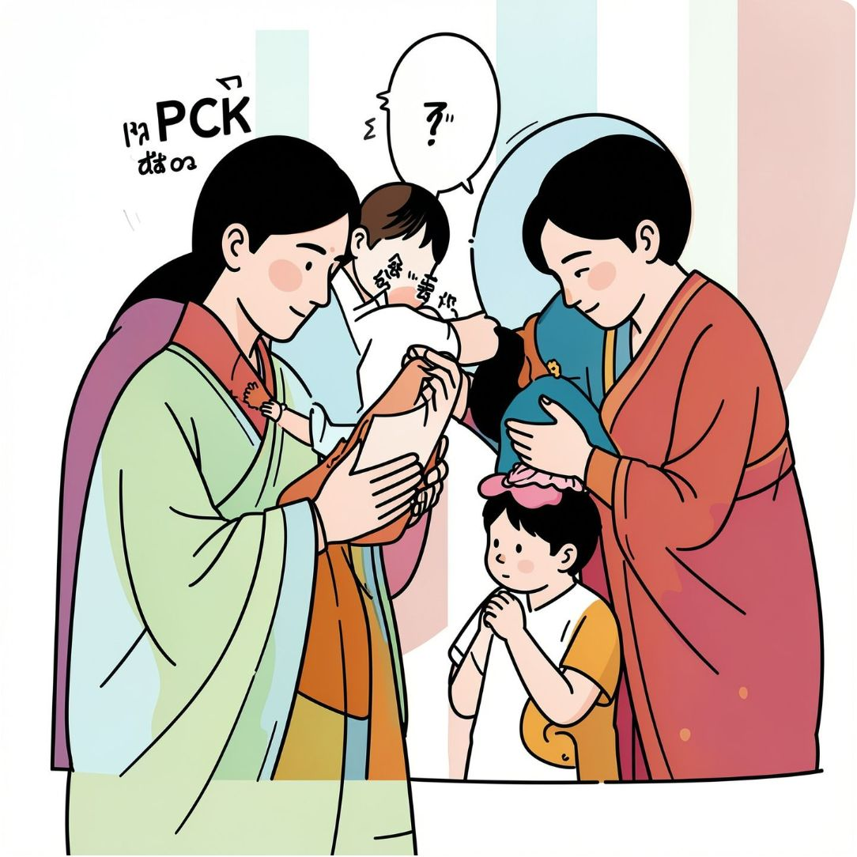

Family Pressure and Caste Dynamics
POCSO, as applied, becomes a powerful instrument of family and community control — not child protection.
Delhi case: The survivor's parents oppose the marriage on grounds of caste difference — the accused belongs to a lower caste. They support quashing the case only to end the financial and time burden of proceedings, not to honor their daughter's wishes.
Rajasthan case: The girl's family weaponized POCSO to threaten and destabilize the boy's family. The girl — who loved him — died by suicide due to the stigma and her family's hostility. She was already facing violence at her home, before she left home.
When families can weaponize POCSO to enforce social norms and honor codes, the Act ceases to be a shield for children — it becomes a sword against them.

Slide 9
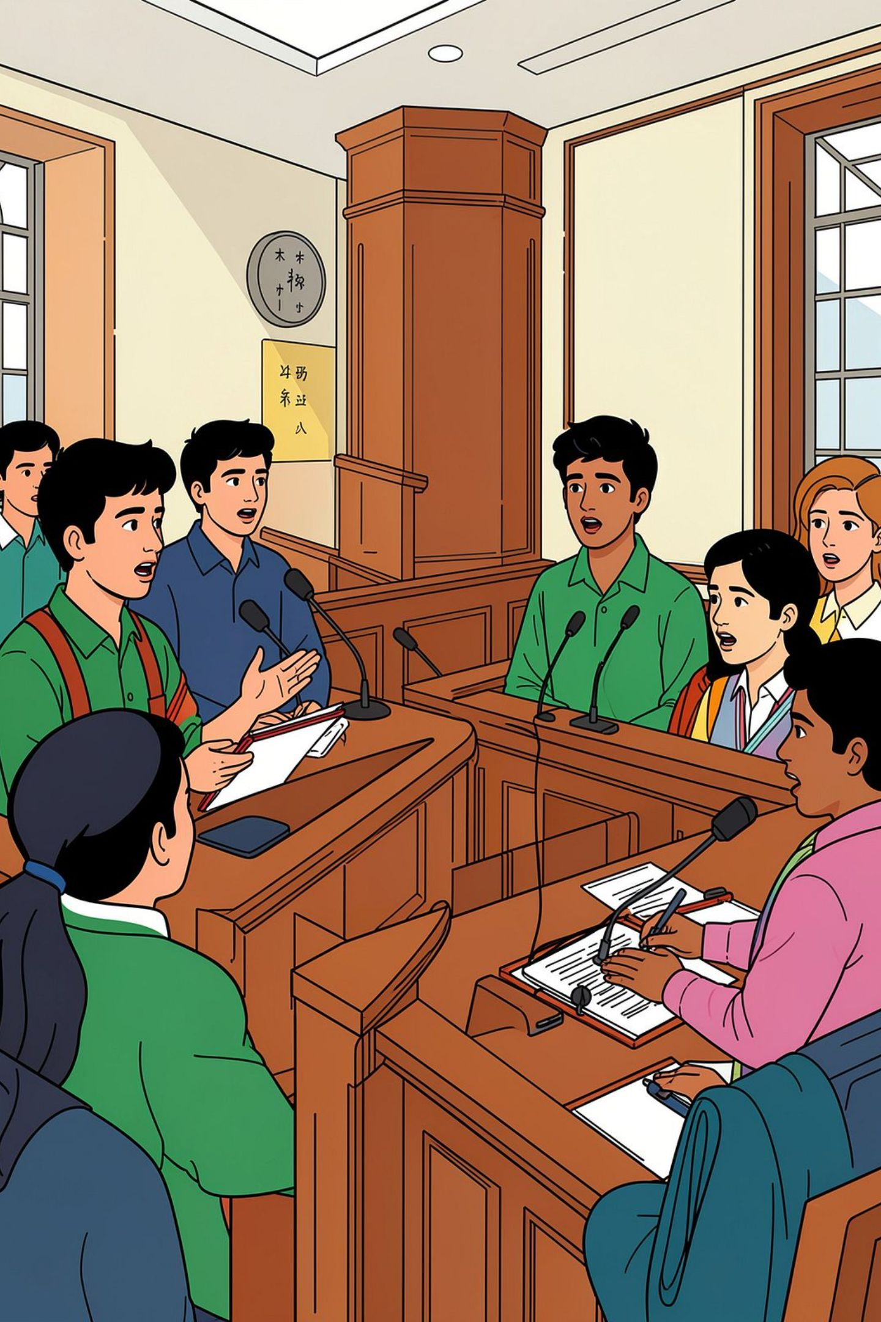


The Disconnect: Legal Identity vs. Lived Reality
Delhi Survivor
"This was consensual. I want to marry him." — Repeated across every stage of legal proceedings. The law calls her a victim. She refuses that identity.
Rajasthan Boy
"Ab main jeeke kya karunga." — "What will I do with my life now?" His first words upon learning of her death, after months detained in an observation home, unaware she was gone.
These are not unique cases. They are evidence of a structural failure: the law imposes narratives that directly contradict adolescents' own understanding of their relationships, their agency, and their dignity. The legal identity and the lived reality are irreconcilably at odds.

Slide 10
Toward Justice: Recognizing Adolescent Autonomy
The cases before us demand not sympathy — they demand structural reform. The following are specific, actionable steps for courts and legislators:
1
Differentiate in Law and Practice
2
Revise the Age of Consent
Establish a clear legal distinction between predatory abuse and consensual adolescent relationships. Treating them identically is neither just nor evidence-based.
Lower the age of consent to 16 with graduated protections and safeguards, recognizing that 16- and 17-year-olds possess meaningful capacity for informed decision-making.
3
Require Evidence of Coercion
4
Centre Adolescent Voices
Criminal prosecution should require demonstrated coercion, exploitation, or power imbalance — not merely an age difference between consenting adolescents.
Establish expedited, adolescent-centered court processes. The survivor's testimony of consent must carry legal weight. Silence her voice, and the law itself becomes the abuser.

Slide 11
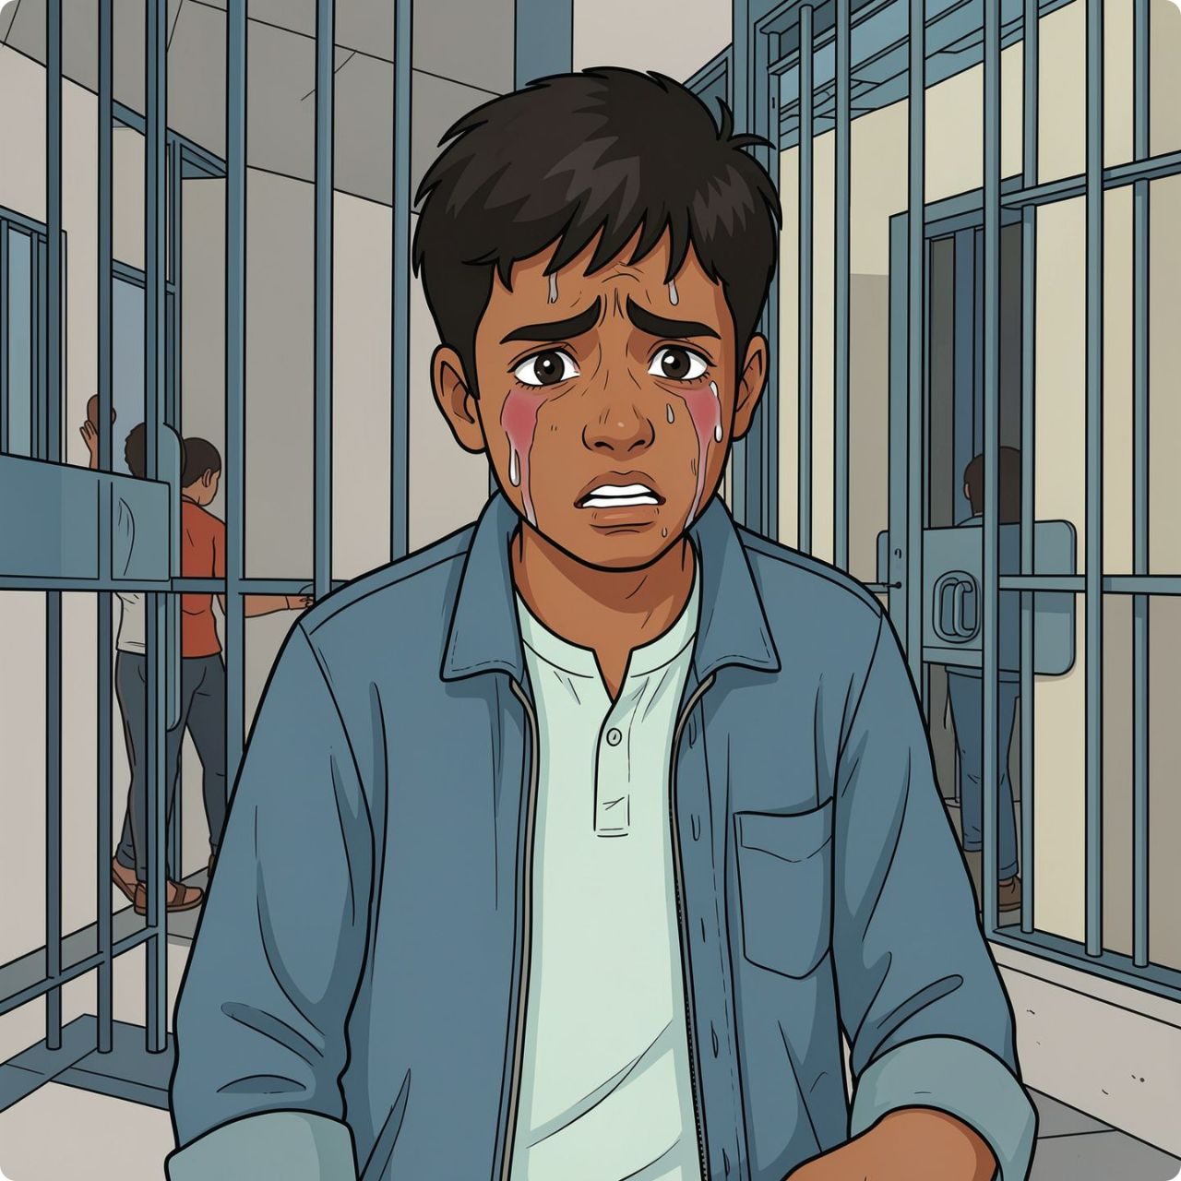
The Boy Trapped by Law — A Timeline of Institutional Harm
Apprehended
1
26 July 2025: 15-year-old boy detained for consensual relationship with 14-year-old cousin. Girl's family weaponizes POCSO; threatens his family.
2
In Observation Home
Months pass. Boy remains detained. Mother struggles to arrange bail sureties of ₹50,000 each and ₹1,00,000 bond. Boy is unaware of what is happening to the girl.
Bail Granted — But Trapped
3
21 January 2026: Bail granted, but mother cannot arrange sureties. Boy remains in observation home despite bail approval.
4
Released — Too Late
6-7 February 2026: Sureties finally arranged. Boy released after 6+ months. Mother tells him the girl died by suicide under family pressure. His first words: "Ab main jeeke kya karunga" — "What will I do with my life now?"

Slide 12
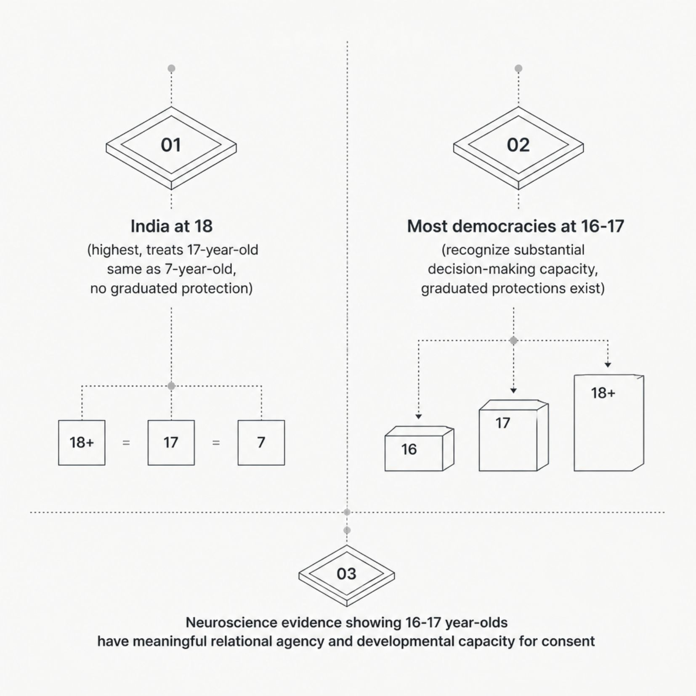
The Age-of-Consent Gap: Law vs. Development
The Developmental Reality
Neuroscience consistently demonstrates that adolescents aged 16–17 possess substantial decision-making capacity in relational contexts — capacity that is categorically ignored by Indian law.
India's age of consent at 18 is among the highest in the world. Most democracies — including those with robust child protection frameworks — recognize the capacity of 16- and 17-year-olds to consent.
The most troubling consequence: POCSO treats a 17-year-old in a chosen relationship and a 7-year-old abuse victim identically — both "children" incapable of consent in the eyes of the law.

Slide 13
Systemic Failures: Court Delays and Institutional Harm
Delhi Case Begins
1
FIR registered; 17-year-old survivor immediately labeled "victim" despite stating consent from day one.
2
Years of Proceedings
Survivor repeatedly asserts consent at every legal stage. Case continues. She relocates to Mumbai; parents move to their village. Proceedings remain burdensome and unresolved.
Rajasthan: Detained
3
15-year-old boy apprehended and placed in observation home on 26 July 2025. Bail granted 21 January 2026 — but mother cannot arrange sureties of ₹1,00,000.
4
Released — Months Later
Sureties finally arranged 6 February. Boy released 7 February 2026 — over six months after detention for a consensual relationship.
In both cases, prolonged legal process traumatized families and prevented the resolution that all parties — including the adolescents themselves — sought.

